Slide 1






DIRECT DETECTION OF EXOPLANETS USING TUNABLE KERNEL-NULLING
Vincent Foriel^{1*}, Frantz Martinache¹, David Mary¹
Nick Cvetojevic¹, Romain Laugier², Marc-Antoine Martinod¹
¹ Université Côte d'Azur, Observatoire de la Côte d'Azur, CNRS, Laboratoire Lagrange, France
² KU Leuven university, Leuven, Belgium * vincent.foriel@oca.eu

Slide 2
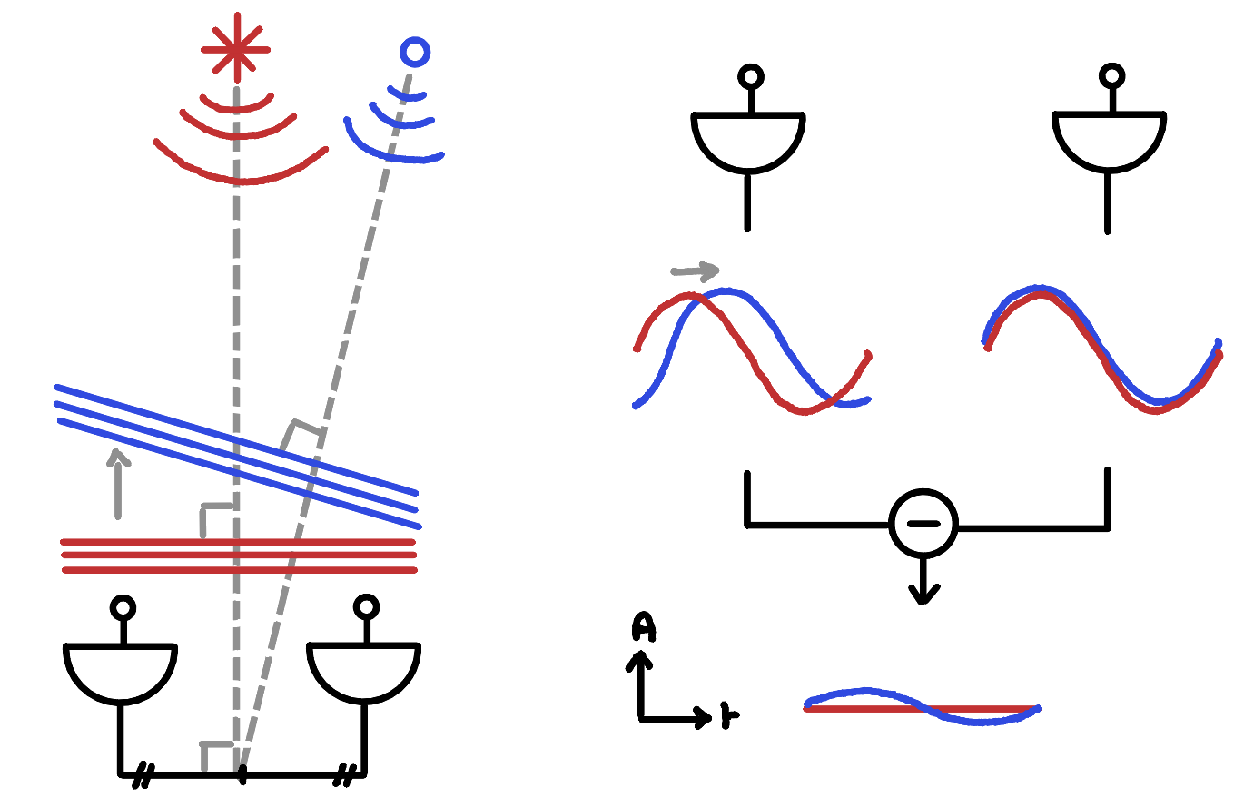
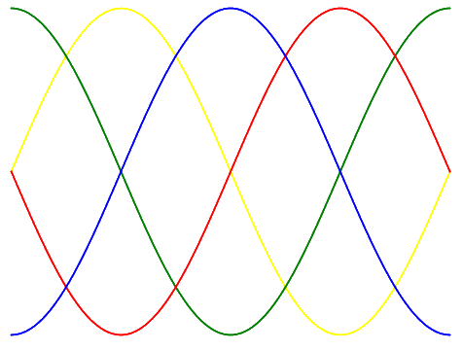
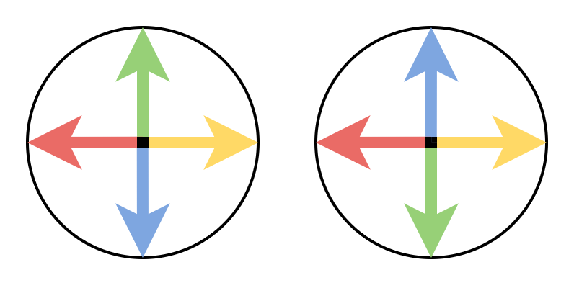
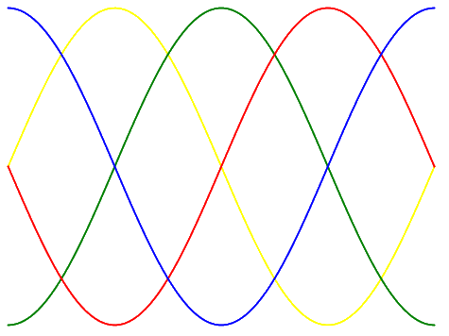
What is Kernel-Nulling?
Extend nulling interferometry
Place signals in phase quadrature
Difference between pairs of symmetric combinations
Robust to first order phase aberations
📚 Martinache & Ireland (2018)
📚 Bracewell et al. (1979)

Slide 3
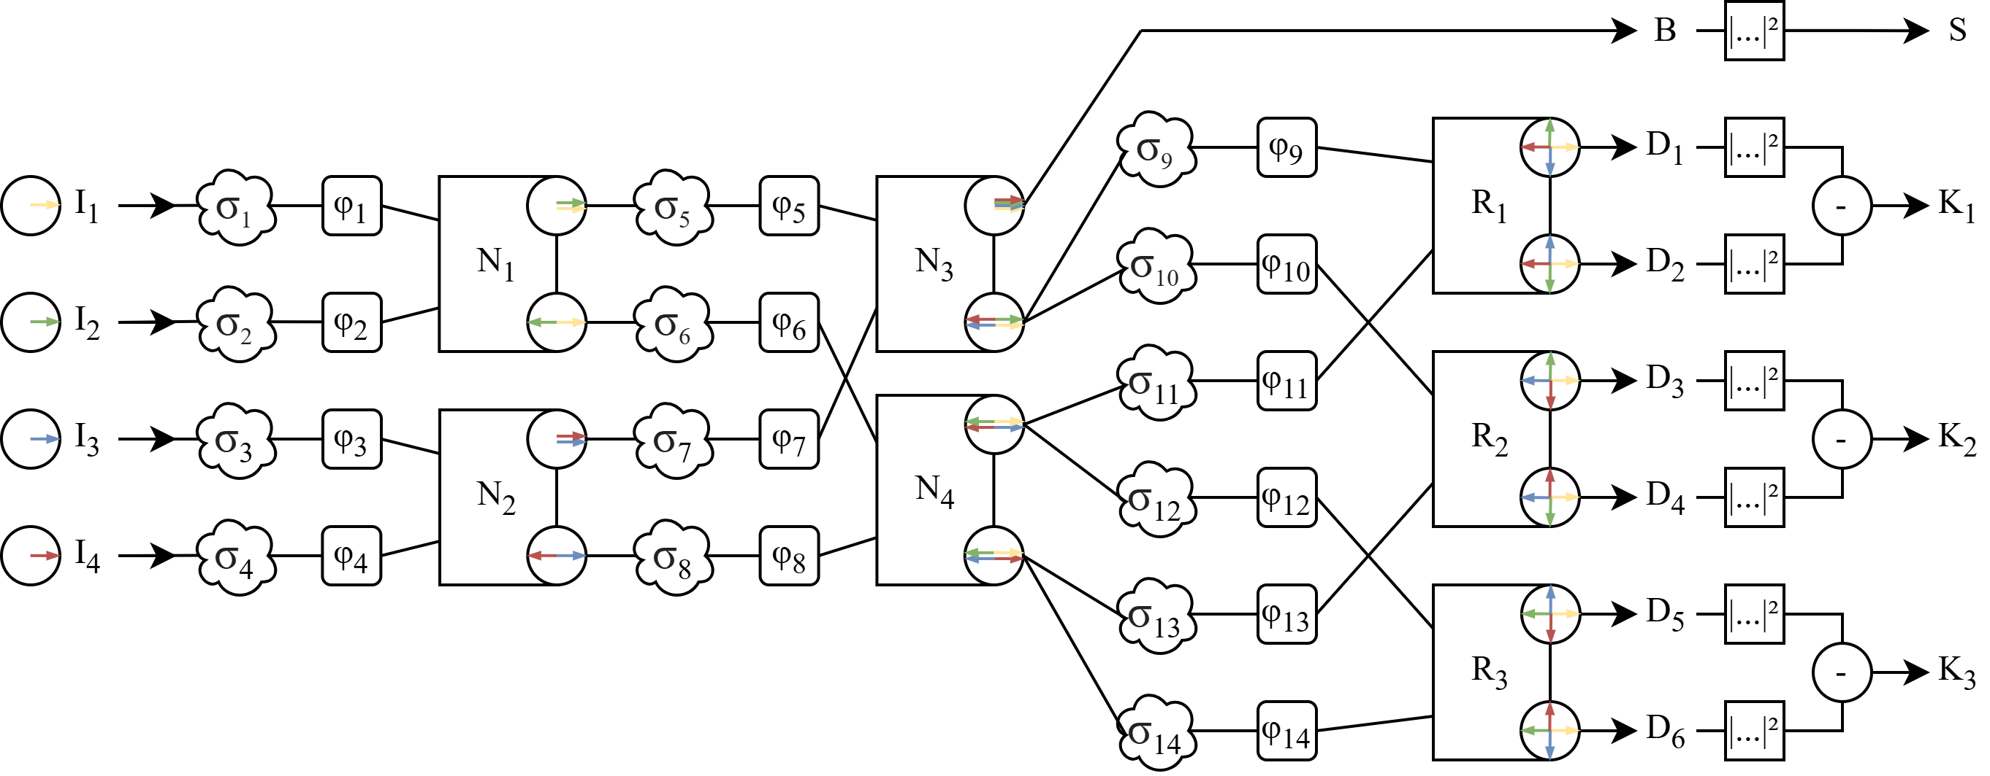
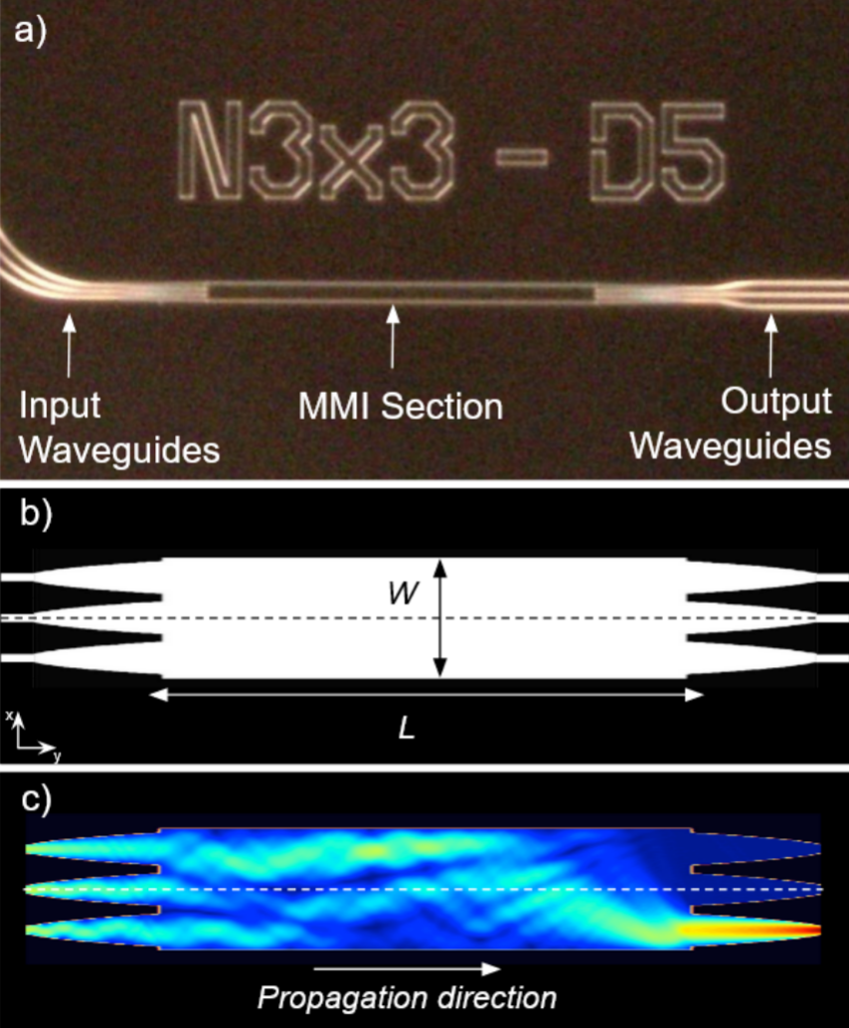
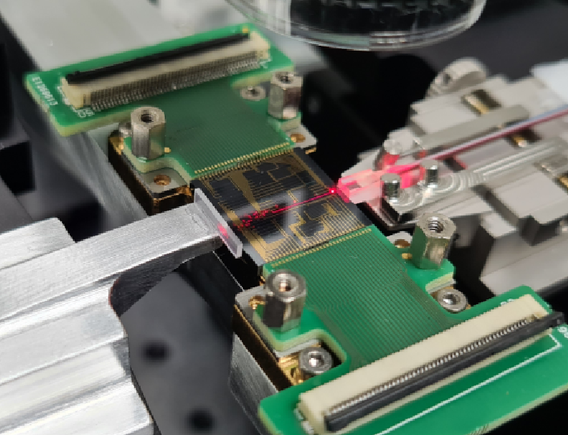
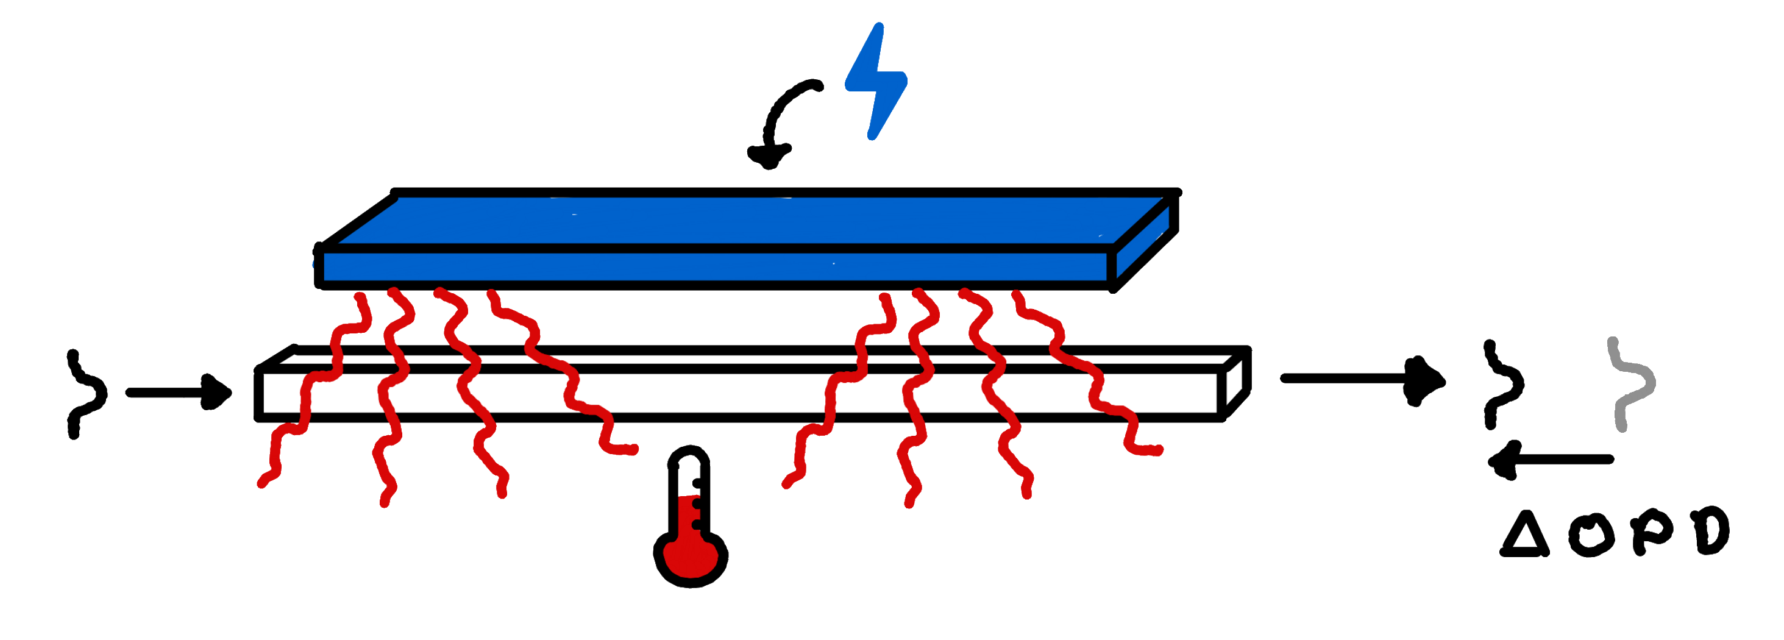
Tunable architecture 🔧
Wave propagation simulation in a MMI 📚 Cvetojevic et al. (2022)
Photonic chip (16mm large)

Slide 4
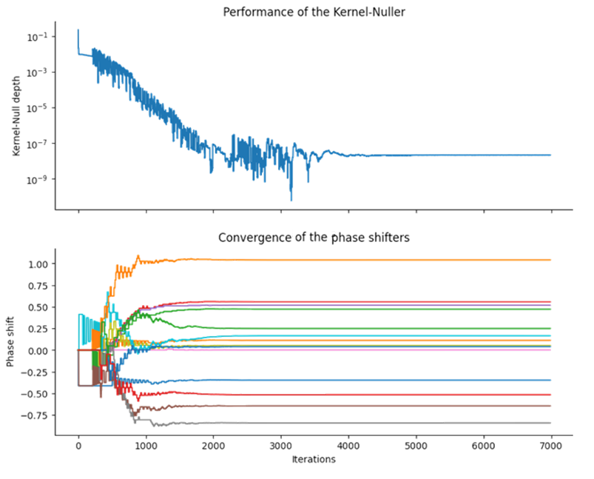
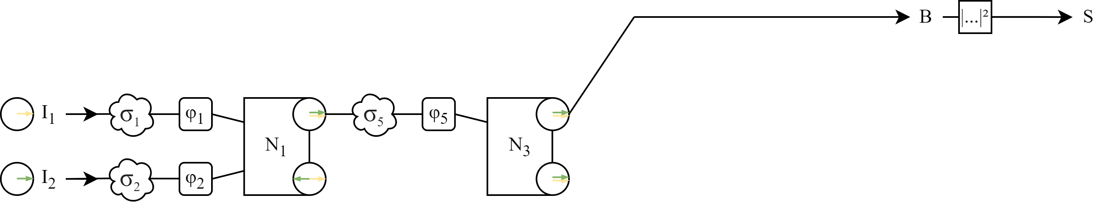
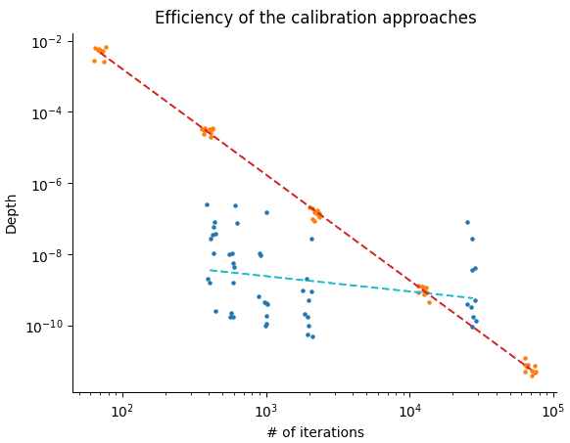

Calibration algorithms

Slide 5
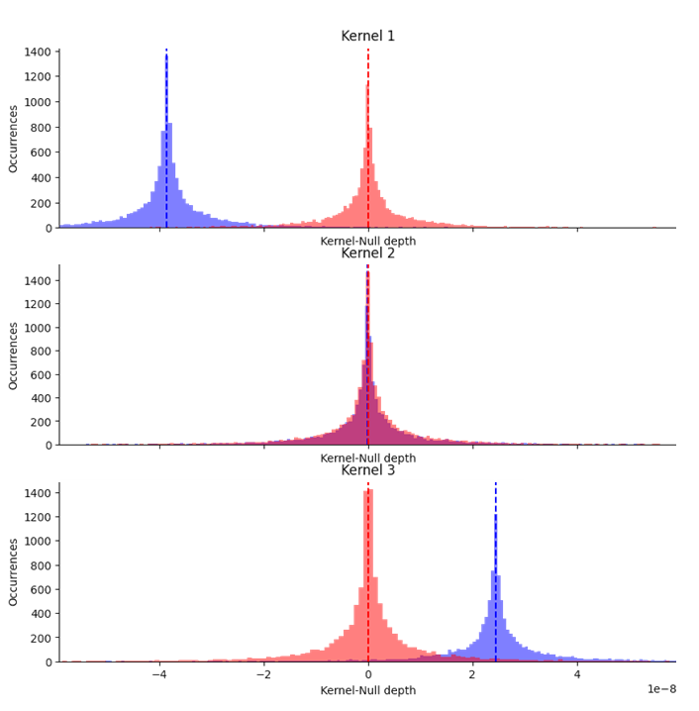
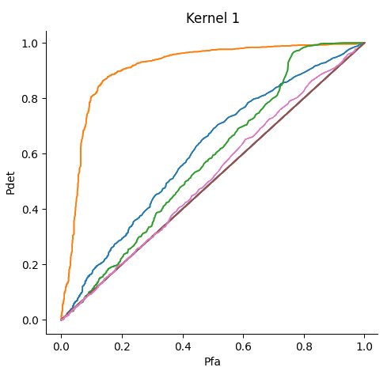

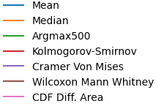

Specific statistical tests
Expected distribution shift for a companion at $c={10}^{−7}$ with an ideal Kernel-Nulling system placed in space
ROC curves

Slide 6
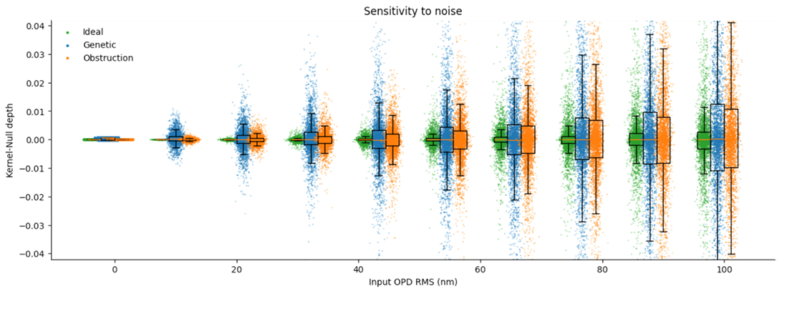



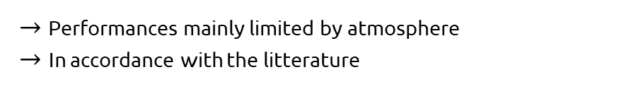

Preliminary results
⚠️ Numerical simulations
$→$ Soon to be validated in lab
VLTI conditions: ${10}^{−3}$ to ${10}^{−4}$
$→$ Performances mainly limited by atmosphere
$→$ In accordance with the litterature
LIFE conditions: ${10}^{−8}$ to ${10}^{−9}$
$→$ Missing perturbation sources in the numercial model?

